Slide 1

Mangrove Monitoring
Ashlesha Vaidya, Sidharth Suresh

Slide 2
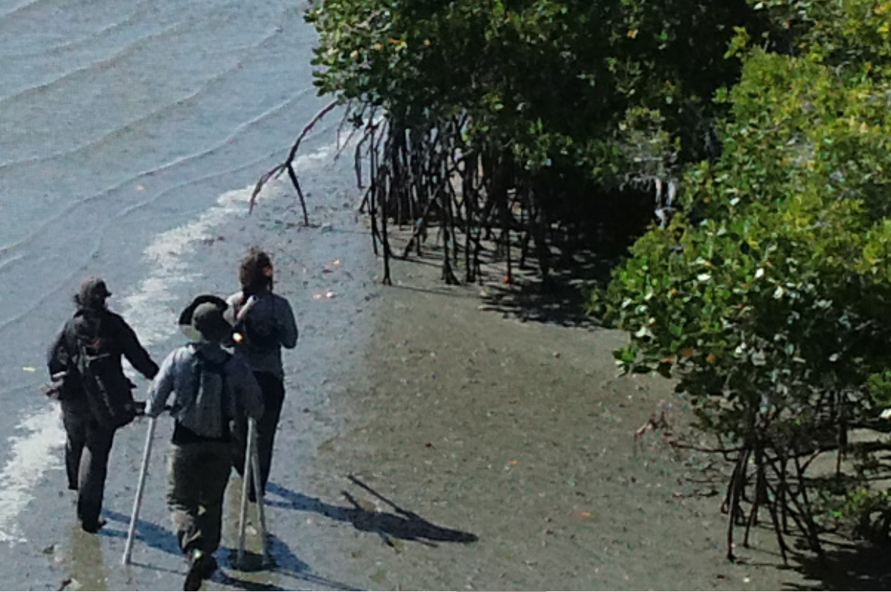
Background
Mangroves are trees and shrubs that have adapted to grow in the intertidal zone along subtropical coastlines. Over 80 species of mangroves span the globe.
Thay have significant impacts on environmental health:
Carbon sequestration
Reduction in coastal erosion
Shelter for diverse organisms
Soil enrichment

Slide 3
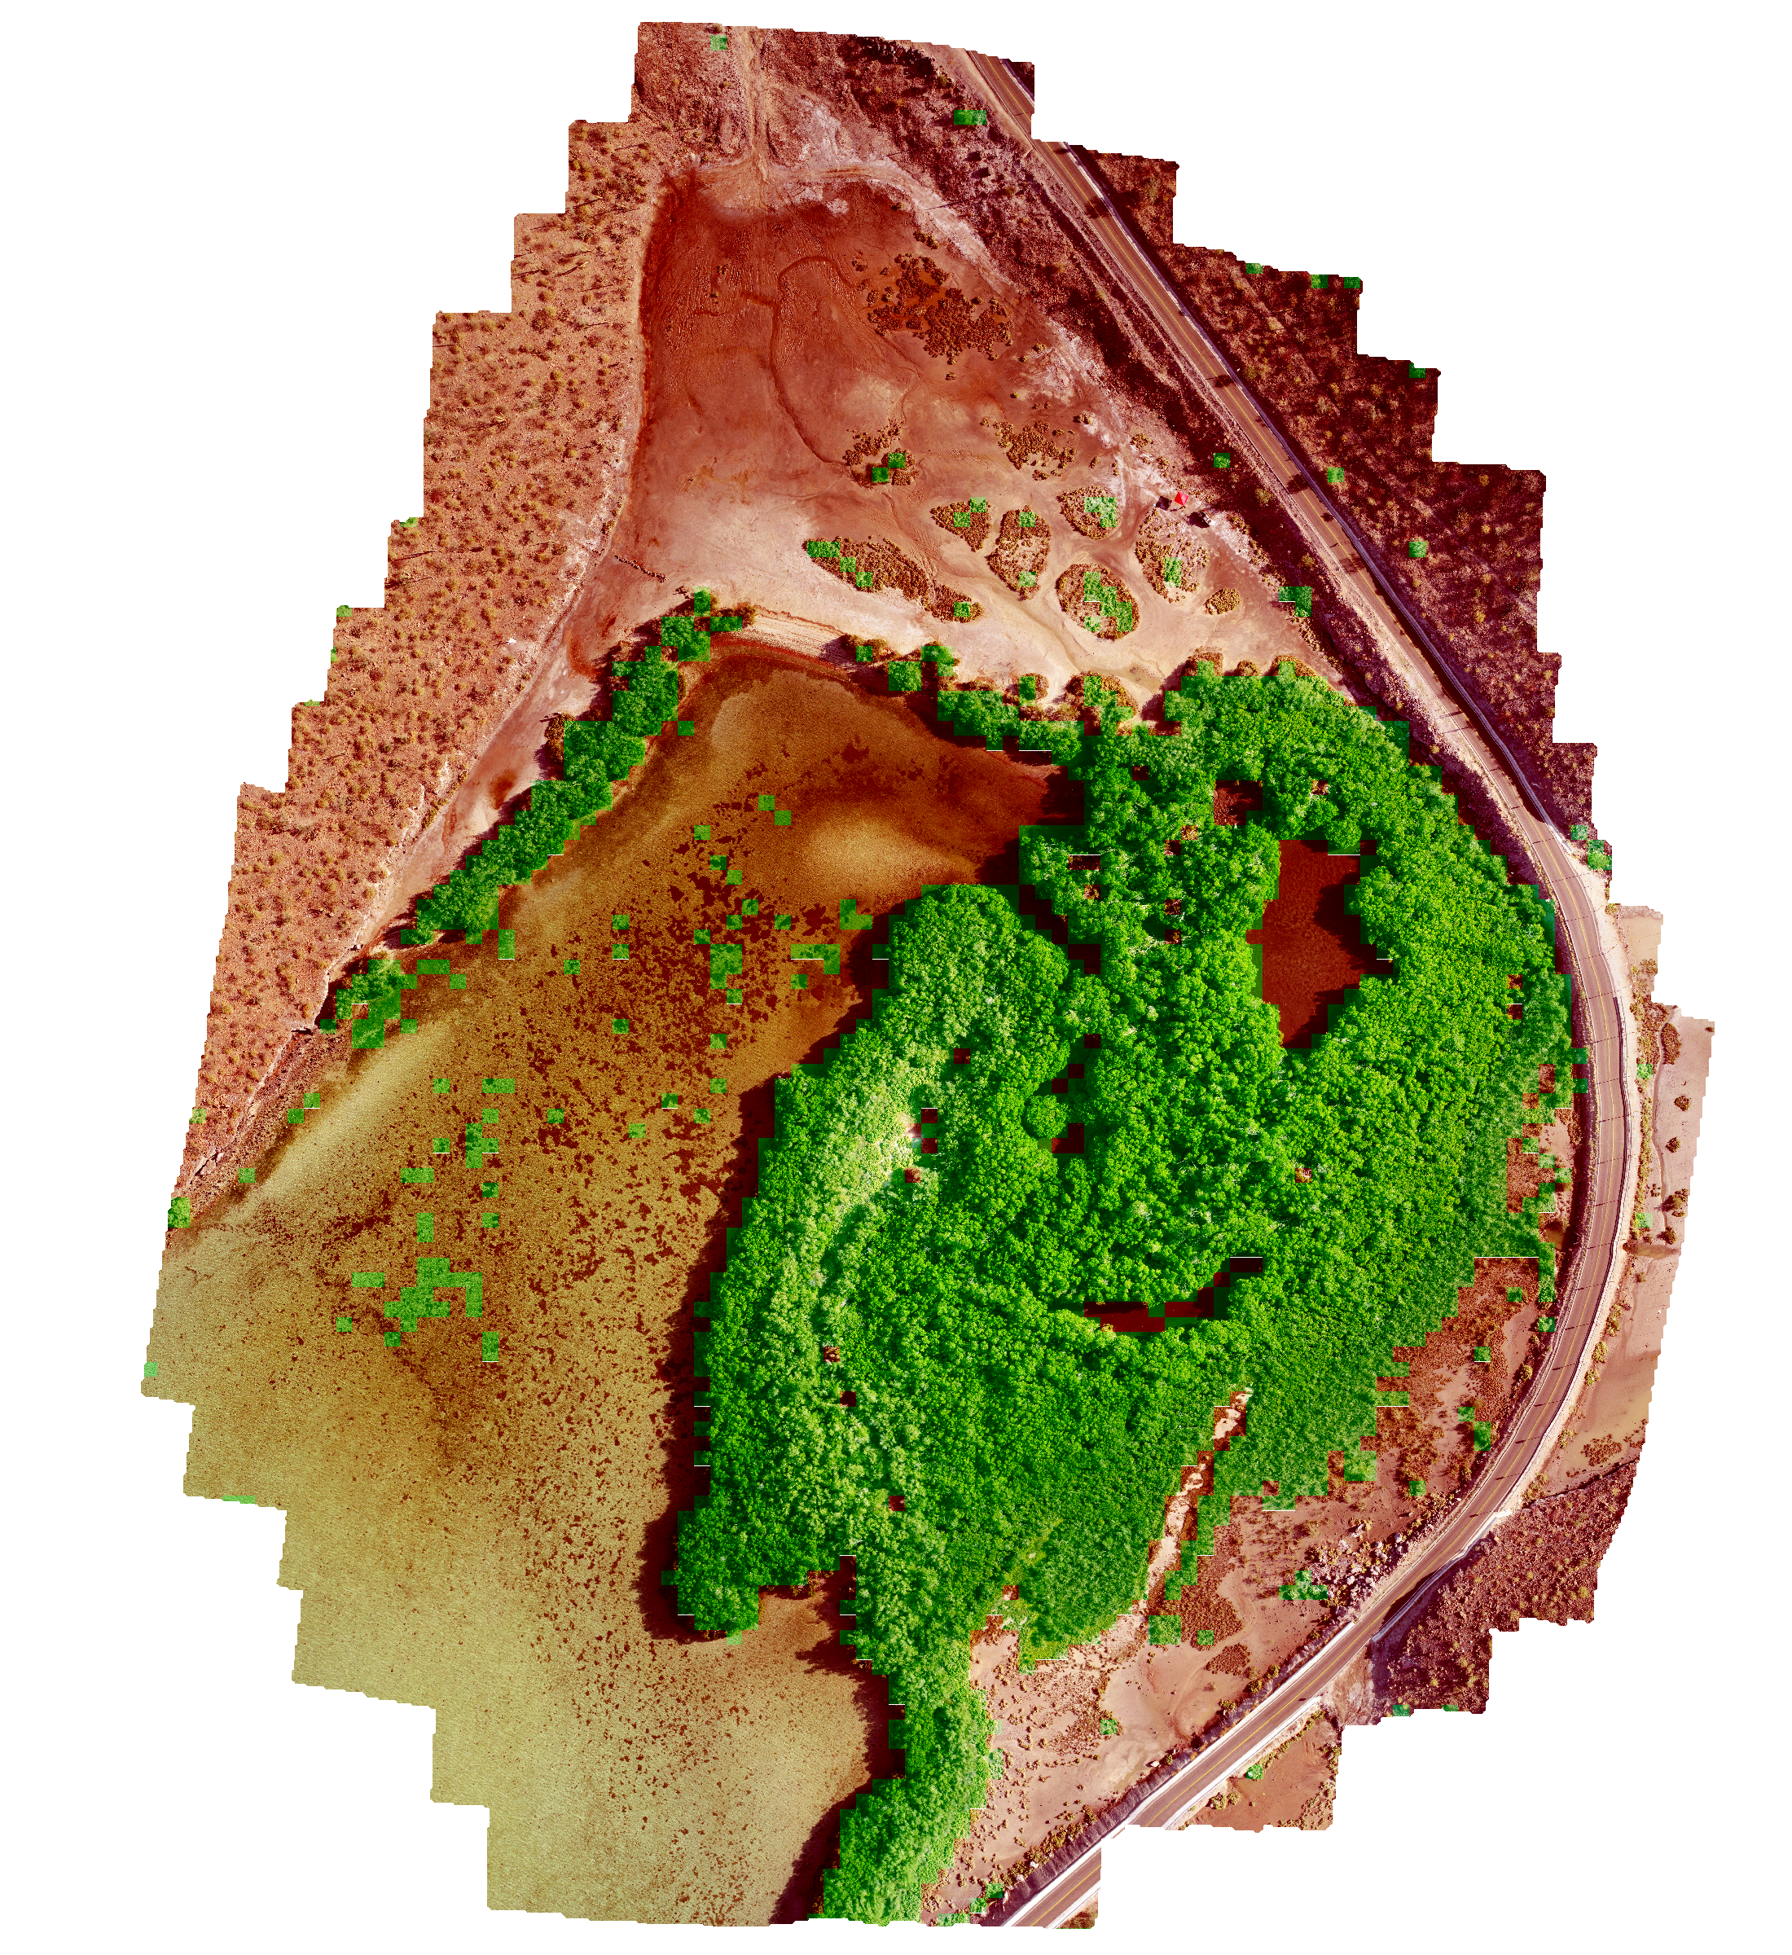
Dwarf Mangrove Species Classification
We are using drone imagery with machine learning algorithms to classify dwarf mangroves.
Data collection process so far :
Field data using drones
Process these images
Hand label images

Slide 4
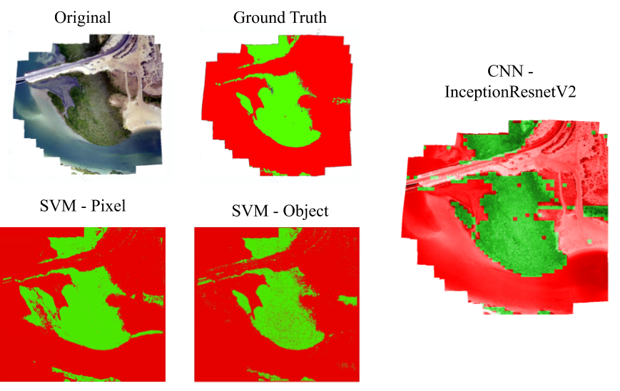
Current Methods
State of the art performance given by CNN with an accuracy of 97-99%.

Slide 5
What’s the problem?
Neural networks are computationally expensive and require a lot of data.
Do not have a lot of labelled data.
Our solution!
Use of labelled and unlabelled together - semi supervised machine learning models.
Cluster then Classify!

Slide 6
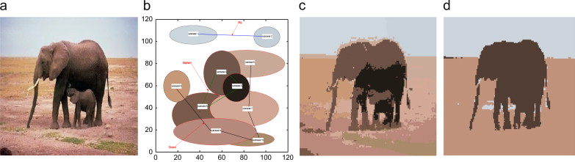
Clustering
Definition - Grouping of similar data points
Mangrove images have a large variance where pixels of different classes maybe similar
Clustering helps to cluster the pixels in these images (ie. region in the image with mangroves together)
Used for training the Classification model along with the available labelled data

Slide 7
Classification
Definition - Predicting the class of a given data point
Given an input image - Perform image segmentation to classify mangroves
Got limited labelled data along with unlabelled data obtained after clustering
Requires less data to train the model compared to Neural Networks
Model to be used : Support Vector Machines

Slide 8
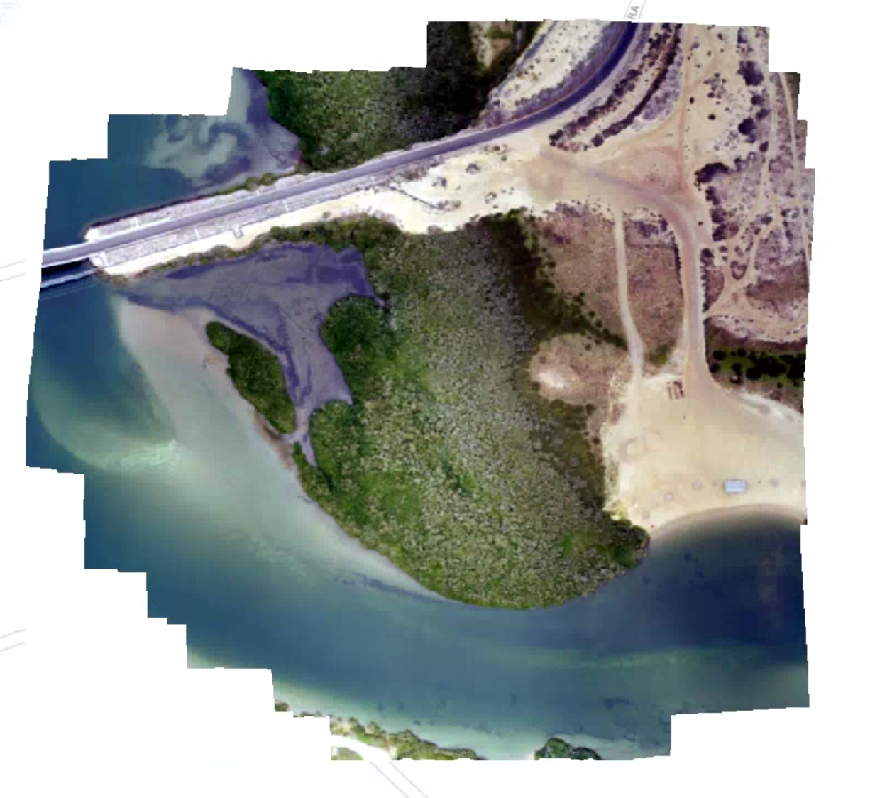
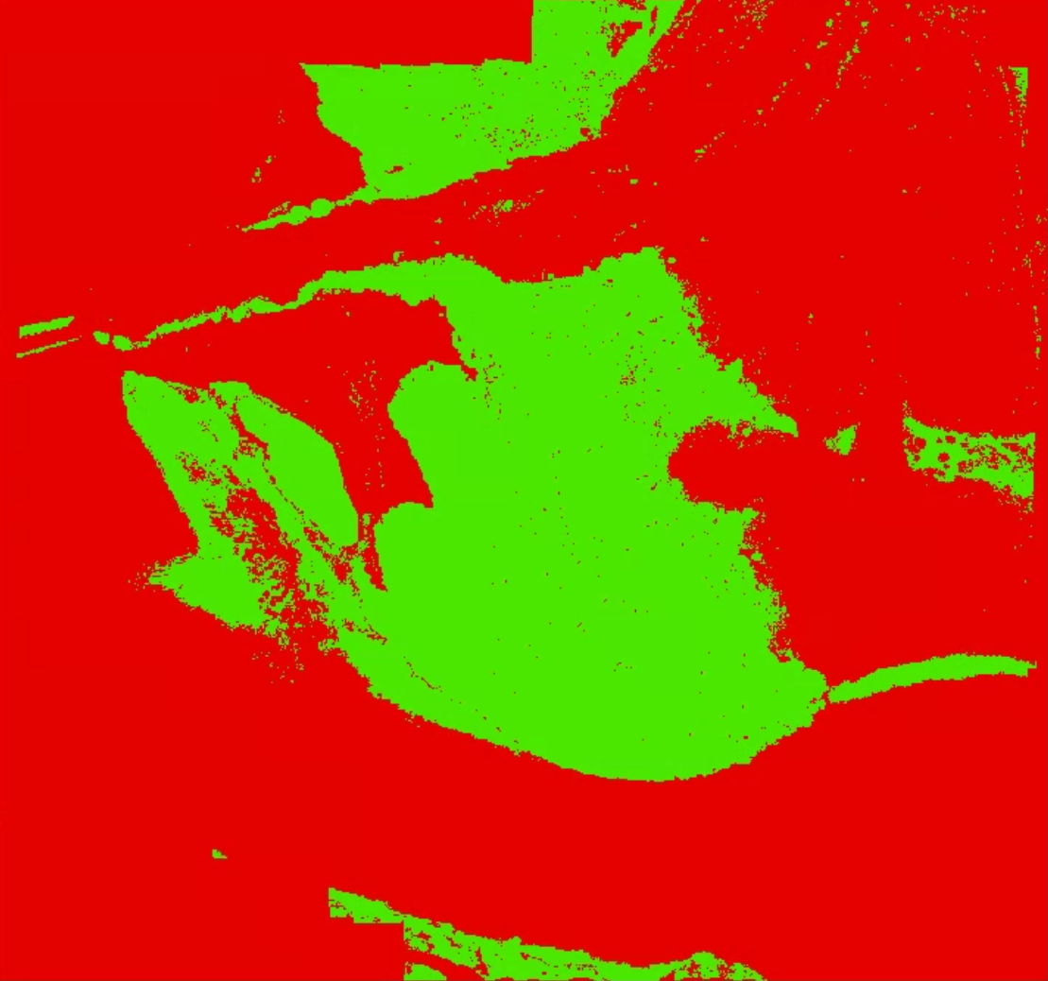
Conclusion
Create a semi supervised model to classify mangroves as efficiently as possible making use of labelled and unlabelled data together.

